Slide 1

Impact Analysis of Affordable Housing Developments on Home Sale Prices
Nashville Software School
Data Science, Cohort 6

Slide 2
Davidson County Home Sales - Data Introduction

Slide 3
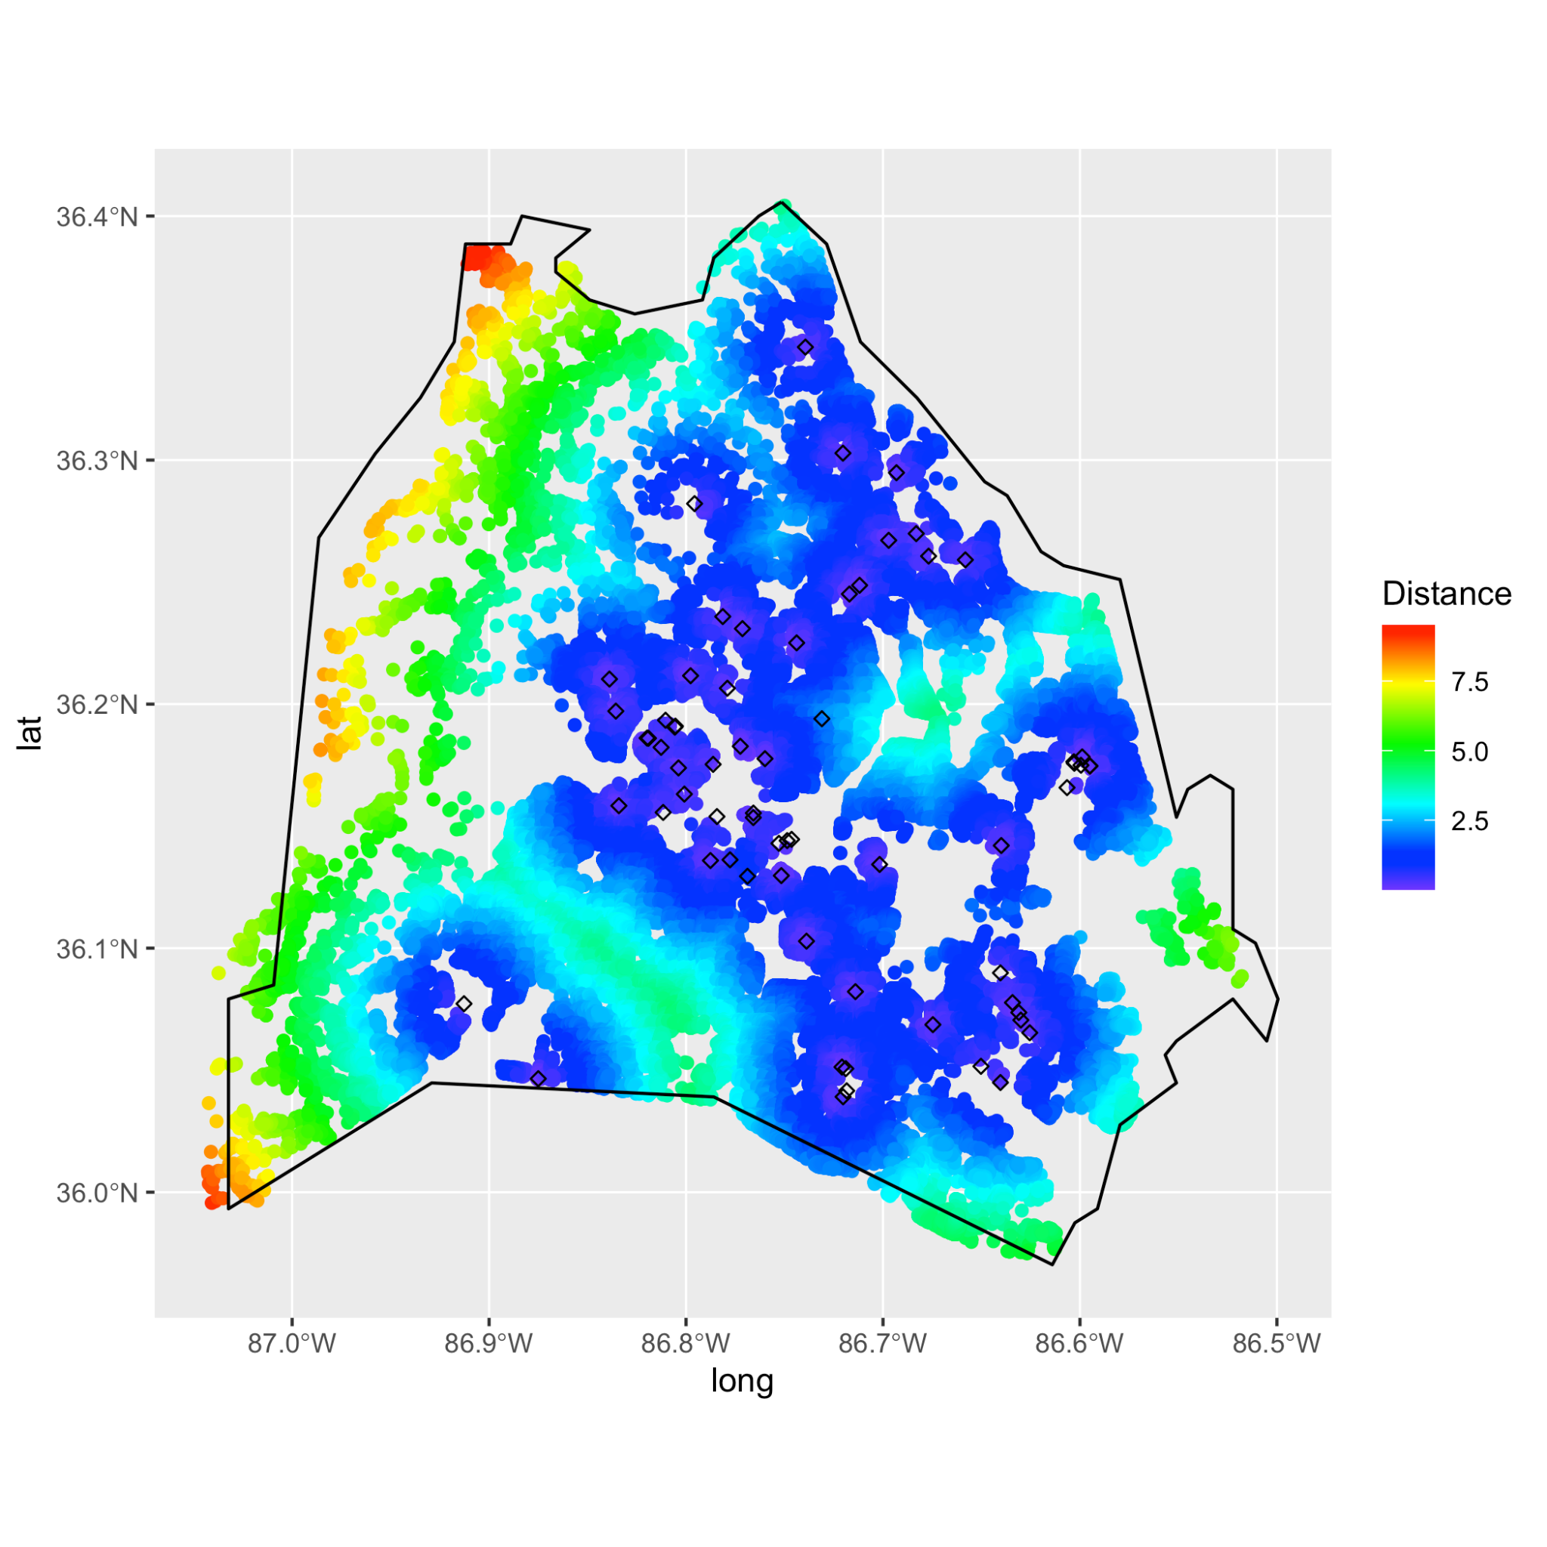
Overview of Home Sales
Single family home sales in Davidson county occurring from Jan 1995 through Oct 2022
Filtered out sales for more than $9 million and for homes over 9,000 sq ft
121,143 homes located in 165 census tracts
293,153 sales in total
Features of home sales explored: square footage, year built, number of rooms, number of bedrooms, number of fixtures, number of baths, distance to nearest development, year of sale, timing of sale relative to development going into service

Slide 4
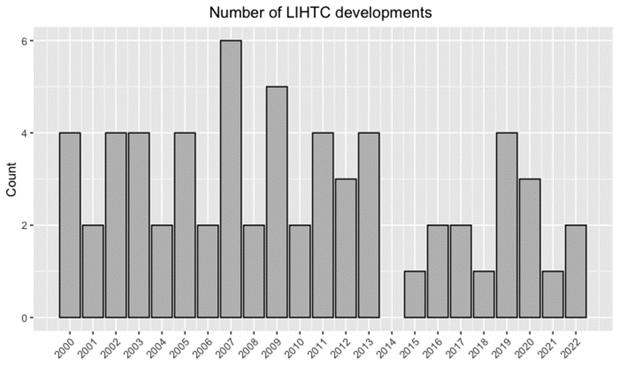
Affordable Housing Developments
In Davidson county, 64 affordable housing developments (AHD) went into service between 2000 and 2022
Developments have between 5 and 482 units
40 developments are located in Nashville

Slide 5
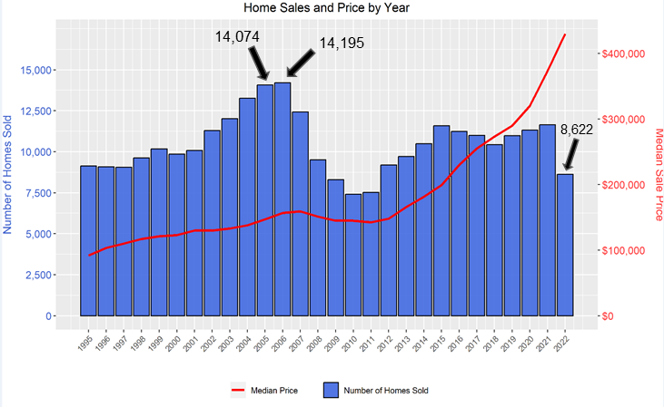
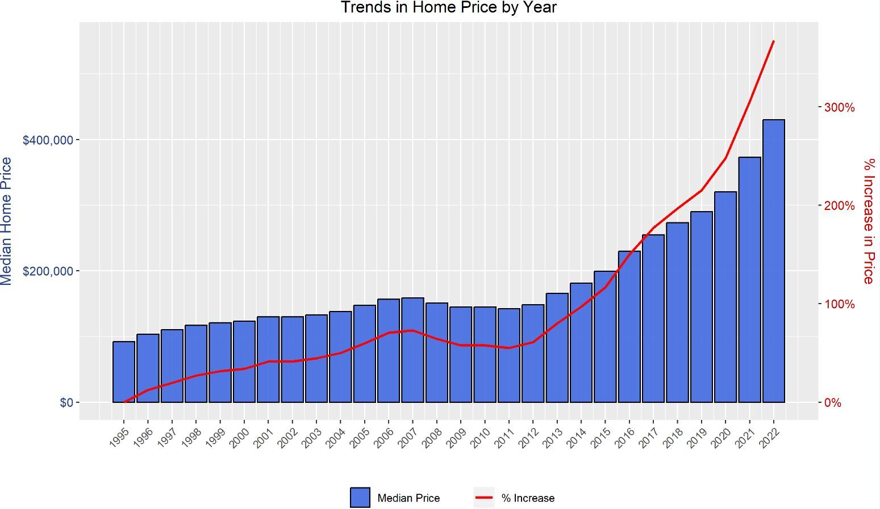
Home Sales Volume and Pricing
Davidson county single family home sales volume peaked in 2005-2006
Persistent & significant increase in median prices starting around 2013
From 1995 to 2022, 367% increase in the median price of single family homes

Slide 6
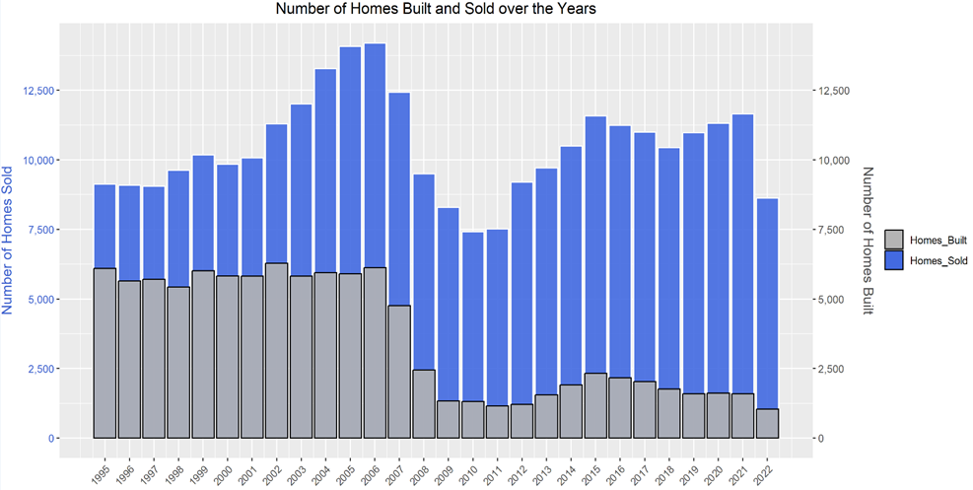
Homes Built vs. Homes Sold
Oldest home in dataset built in 1796
83% fewer homes built in 2022 as compared to 1995
Difference between number of homes built and number of sales generally increasing over this time frame

Slide 7
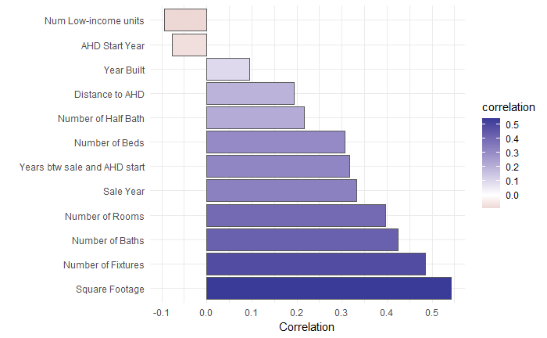
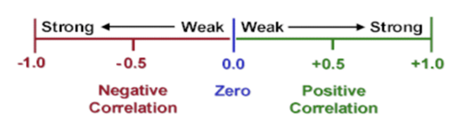
Features Correlated with Price
Home size (square footage) has the strongest correlation to sale price of all features explored
The correlation is positive meaning as square footage increases, sale price also tends to increase

Slide 8
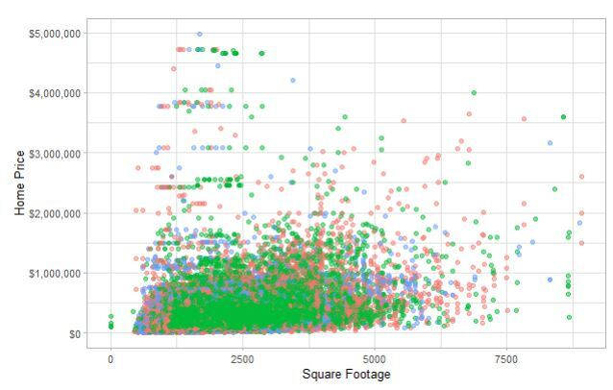
Home Size and Sale Price
Correlation value = 0.542
Showing here only sales taking place within 1.5 miles of the nearest AHD
Colors show groupings of sales within ½ mile radius “rings” around the nearest AHD

Slide 9
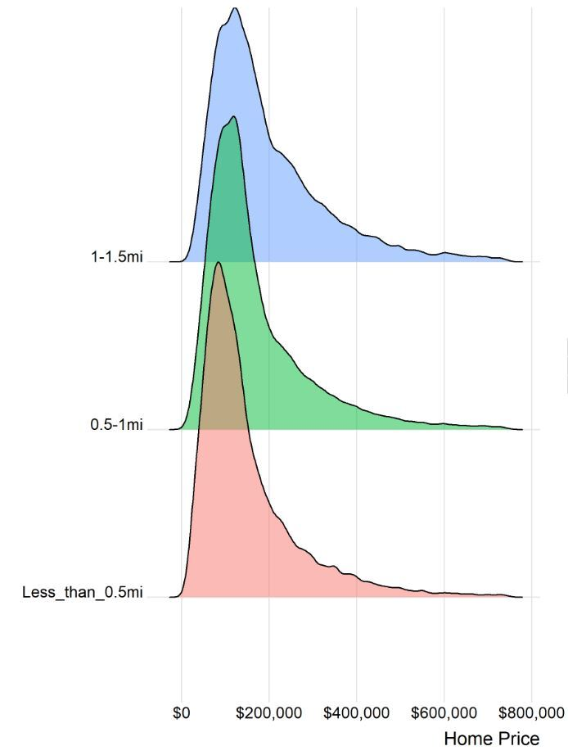
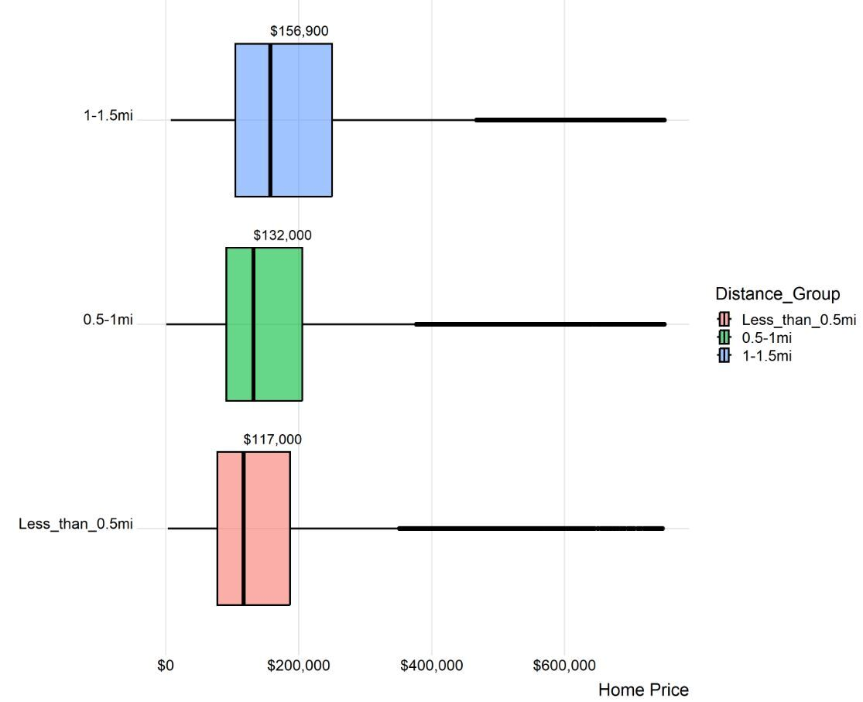
Sale Price Distributions near AHDs
Home sales between 1995 and 2022 grouped into ½ mile radius rings around their nearest AHD show largely overlapping distributions

Slide 10
Statistical Models

Slide 11
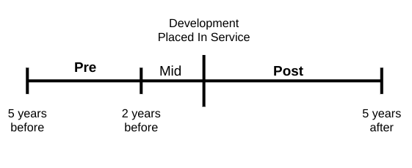
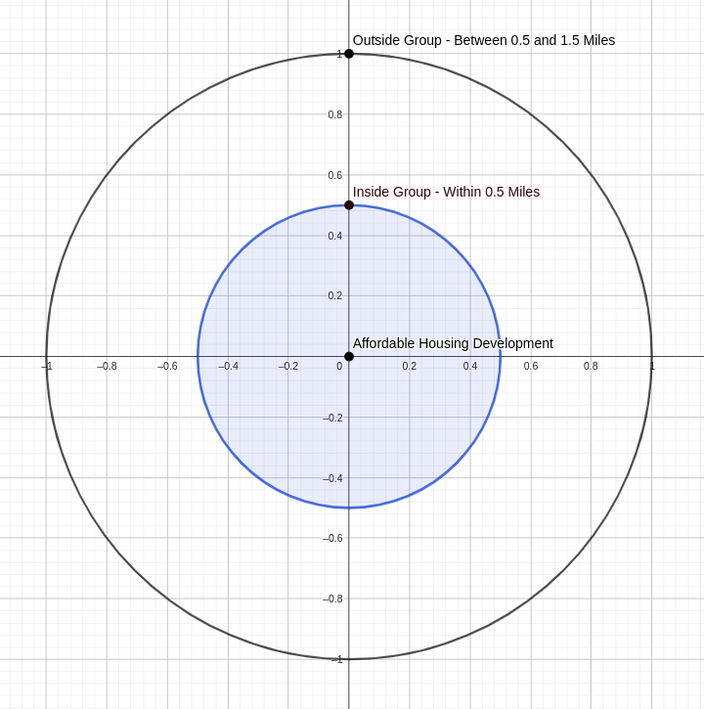
Initial Statistical Model
Followed methodology in an academic paper exploring the impact of affordable housing in New York City (Ellen, Schwartz, Voicu [2007]).
This regression model accounted for: home size, age, neighborhood (census tract), land area, and sale group (defined below)
Conclusion: Homes placed in the inside group tended to be priced about 5% lower than comparable homes in the outside group. This difference was statistically significant and held true for five years after the establishment of the AHD. No statistically significant difference before and after the development was placed in service.

Slide 12
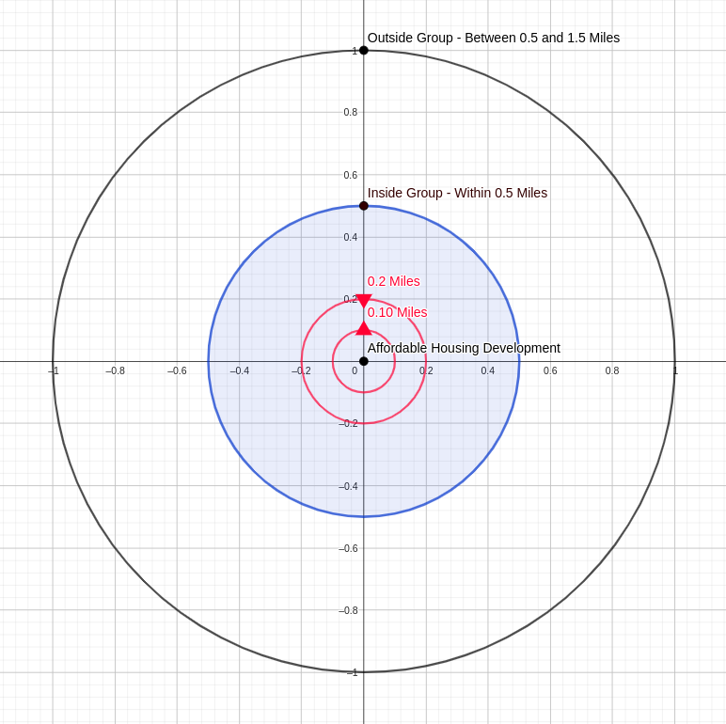
Additional Statistical Models
Adjusted the radius that defined the pre/mid/post groups (0.1 mile and 0.1 - 0.2 miles)
Adjusted the outer radius of the outside group (1.5 miles vs. 1 mile)
Dropped the restriction of sales being within 5 years of the AHD going into service
Looked at various combinations of the above
Conclusions:
For the bands within 0.1 mile and between 0.1 and 0.2 miles of AHDs, there may be slight, but statistically significant, lowering of appreciation compared to the outside group.

Slide 13
Statistical Model - Caveats
Any statements about impact should be interpreted in terms of impact on potential home value appreciation, not impact on actual home value
The statistical models did not account for the size (number of units) of the AHD
Uncertainty:
  Each home sale is associated with exactly one AHD, the one it is nearest to
  The models did not account for how a home sale price could be affected by being near to more than one AHD.
  Geographical features such as closeness to waterways, roadways, and county borders were not accounted for in the model.
The results cannot represent definitive conclusions, though, they may provide a useful foundation for future analysis

Slide 14
Further Data Exploration

